Slide 1

Serverless CQRS
.NET Core 3.1 – AWS Serverless Lambda

Slide 2
Warm-up
What is Serverless?
Serverless computing is a method of providing backend services on an as-used basis. Typical offerings allow for amazing scaling for a fraction of the cost.
Why AWS Lambda for Serverless?
Let me be frank, it is a preference now. Azure and Google Cloud Platform are perfectly fine and acceptable (GCP doesn’t support .net)
What is CQRS?
Command and Query Responsibility Segregation. Solves the problem of over-complicating models

Slide 3
When (or not) to use Serverless
Pros
Cons
Typically easy deployment
In any cloud offering, serverless is getting easy to deploy
Cost
Typically much cheaper than dedicated hardware running when not needed
Cool Factor
It is just cool to say!
Heavy Processing
If you are running some genome calculations, don’t use serverless!
Although, triggering through serverless is fine! Imagine spinning up those hunk vertical scaled machines only when needed via some trigger that YOU control.
Long Runtimes
There are limits to serverless, similar problem above

Slide 4
When (or not) to use CQRS
Pros
Cons
Collaborative domains
users access data in parallel
Task-based user interfaces
users are guided through complex processes
Think some complicated wizard
Performance needs
Read times need to differ from writes
Team separation
Separate responsibilities from reading and writing
Easier Evolution and Integration
Too simple
This is for complicated systems.
If your problem set is simple, do the easiest solution!
Simple CRUD is sufficient
Again, don’t over-complicate things just because you can ☺

Slide 5
Some Prerequisites
Obviously have .net core 3.1 (sdk et. al.) installed
Get the AWS Toolkit
AWS Toolkit for Visual Studio
AWS Toolkit for Visual Studio Code
Some RDMS (for this example I am using MySQL)
Drink Coffee
Start Coding!

Slide 6
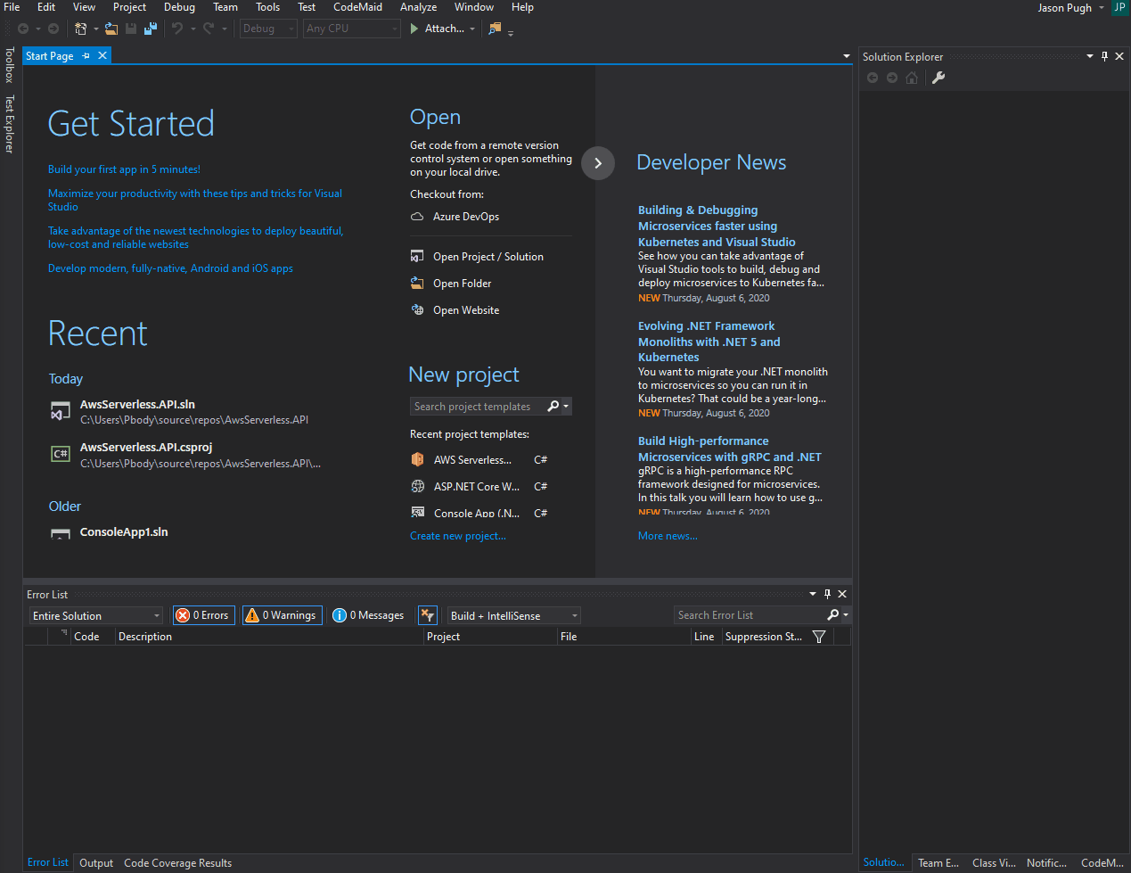
Make your serverless project

Slide 7
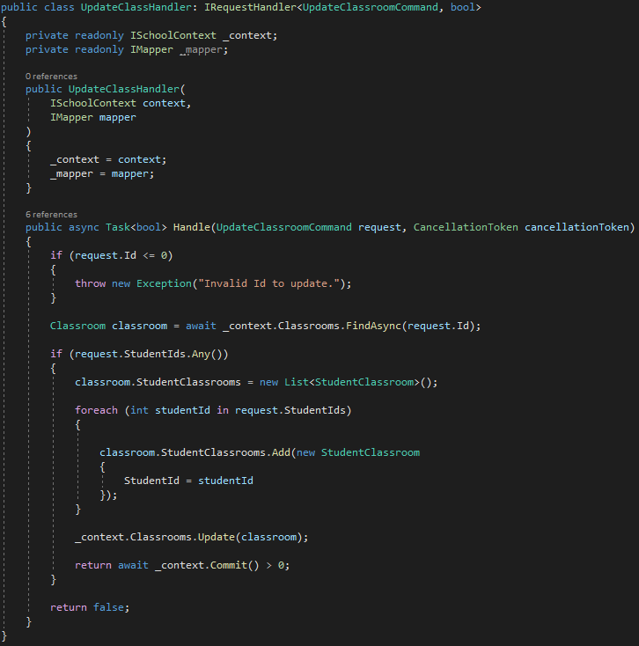
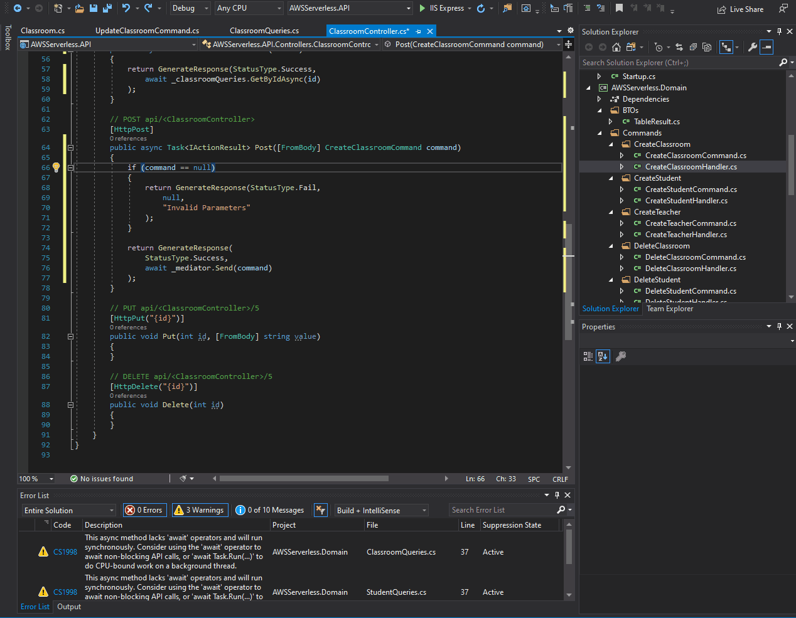
CQRS

Slide 8
Off to AWS
It is part of the context menu so not worth making a gif for that ☺.
Code is available in GitHub.

